Slide 1
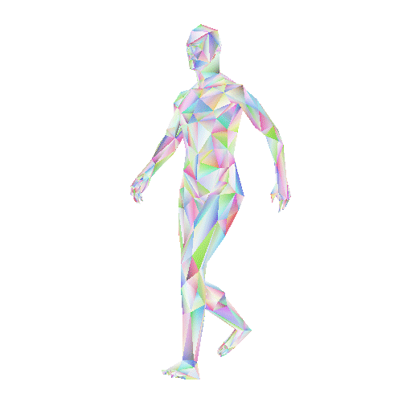
Stationary Exercise Classification using IMUs & Deep Learning
Andy Heroy
Samantha Sprague
Zackary Gill
Primary Advisor: Professor John Santerre, PhD Secondary Advisor: David Stroud Business Advisor: Jon Brodsky
Notes:
(12 seconds)(SAM)
Welcome, my name is Samantha Sprague and my partners are Zackary Gill and Andy Heroy. Today we will present our solution to classifying stationary exercise using Inertial Measurement Units and deep learning.

Slide 2
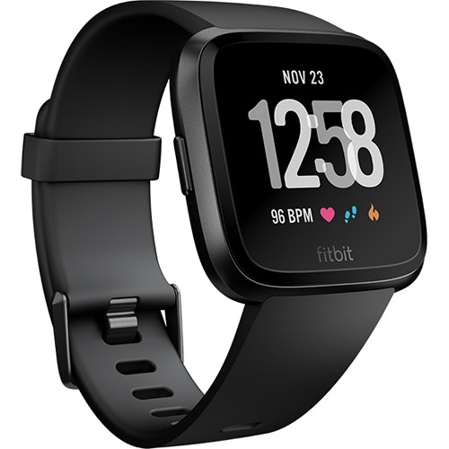
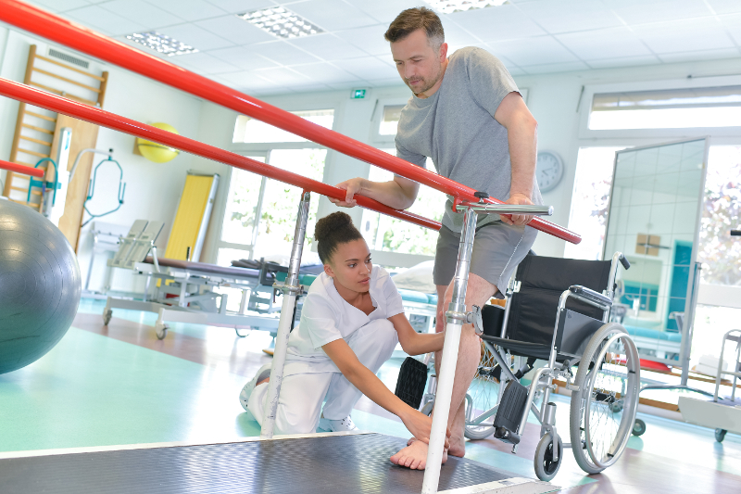
There is no existing analysis on the classification of stationary exercises.
Notes:
(31 seconds)(SAM)
The problem statement for our capstone project was born out of frustration as active users of wearable fitness technology. For me, that frustration stemmed around the fact that my apple watch could not accurately detect when I would perform stationary movements during my weekly spin and CrossFit classes. Modern fitness devices cannot accurately detect and classify stationary exercise movement, and there is no existing research analysis on the classification of stationary exercise using IMUs.
------------------------------------------------------------------------------------------------------------------------------------------------------------------------------------------------
#Old
Raise your hand if you relied on a fitbit or Apple watch to track your fitness performance? I do as well. (Points to apple watch).
#Leftover from previous presentation
Measuring physical performance has been an area of both research and product development in the health and fitness market. Whether it be fitbits, heart rate monitors, or video tracking software -- consumers have showcased an interest in collecting and consuming data surrounding their physical activity. Today’s modern fitness market has a multitude of different fitness tracking devices -- leveraging GPS and heart rate monitoring software in compact wearable technology, however, our problem statement centers around the fact none of these devices can accurately detect and classify stationary exercise movement.

Slide 3
Commercial Solutions
Commercial Option | Price Range | Stationary Capture | Capture Mechanism
Fitbit | $50 - $230 | No | Heart Rate/GPS
Polar | $100 - $250 | No | Heart Rate/GPS
Apple Watch | $350 - $400 | No | Heart Rate/GPS
Whoop Strap | $30/Month | No | Heart Rate/GPS
Tonal | $3000 | Somewhat | Video/Strain Gauge
Notes:
(33 seconds)(SAM)
Research in Human Action Modeling is largely centered around classifying moving exercises: like walking, running or cycling while using modern fitness trackers as data collection tools. As you can see above, popular trackers incorporate heart rate and GPS data to create custom calorie and ex-err-tion algorithms. These methods have been the industry standard. This approach makes classifying active movement MUCH SIMPLER in comparison to its STATIONARY counterpart BECAUSE DISTANCE contains high predictive power in their classification algorithms.
-----

Slide 4
Our Solution
Construct and optimize deep learning models for the classification of stationary movement using three Inertial Measurement Unit (IMUs) attached at the wrist, waist, and ankle.
Notes:
(14 seconds)(SAM)
In our solution, we propose that IMU’s could expand the information space of available data and hold predictive power for classification of stationary movement without the need of heartrate or GPS data.
-------------------------
We build deep learning models using the data generated from IMUs, to navigate this complex data landscape.
121 seconds = Sam

Slide 5
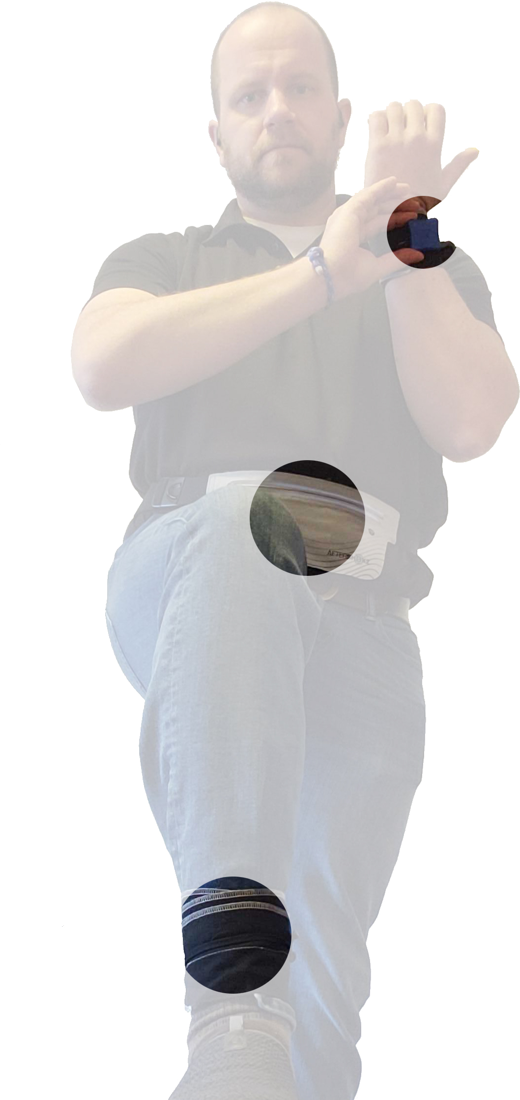
Executive Summary
Opportunity to revolutionize the health and fitness market.
Generated our own dataset for stationary exercise.
Built model construction, optimization and validation software.
Determined most successful model structures for stationary movement.
Notes:
(25 Seconds)(ANDY)
What makes our solution novel is that we generated a dataset of stationary exercise and built a universal/generic model construction and optimization software that automatically builds all valid model architectures from a list of model types. This tunes those architectures by performing a robust gridsearch of data and model hyperparameters. This generated models that indicate the best neural network type which can then be used in subsequent iterations of our process.
-----------------------------------------------------------------------------------------------------------------------------------------
This program allowed us to build 270+ models for the classification of stationary movement at greater than 95% accuracy.

Slide 6
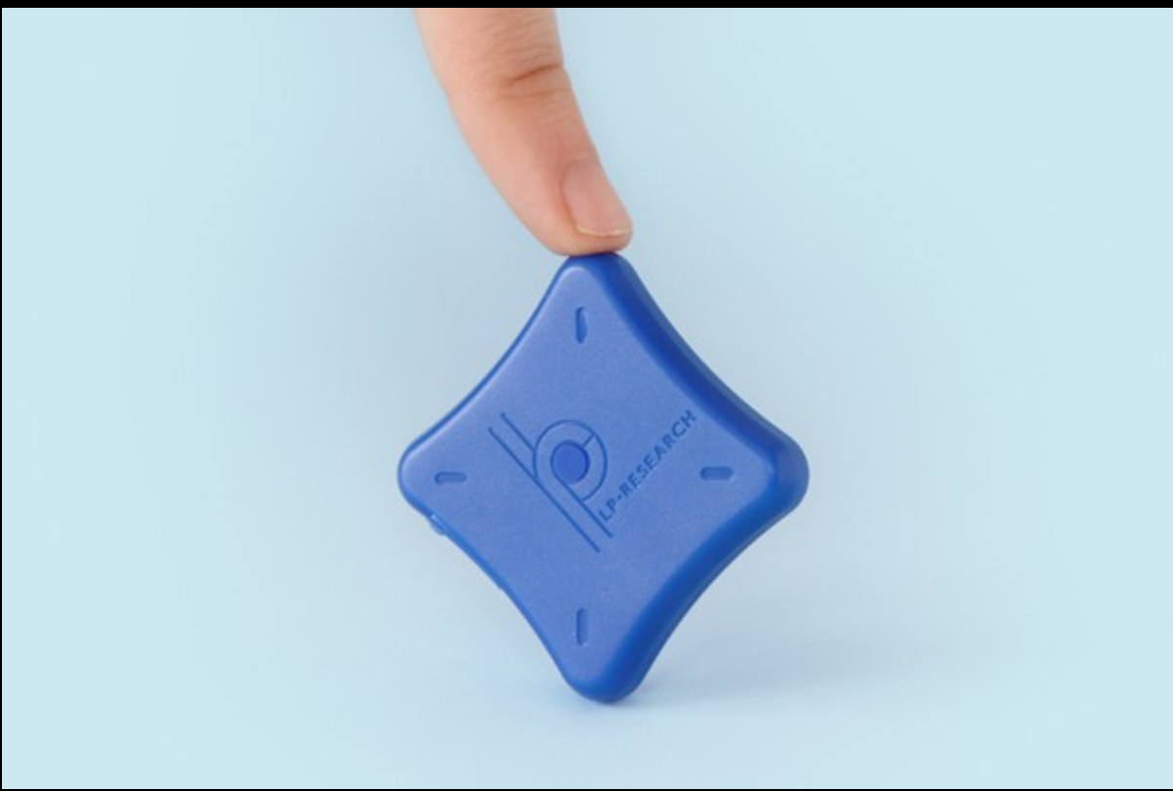
Experimental Design
Sensors placed on left wrist, waist, right ankle
Magnetometer and gyroscope calibrated before every session.
Data collected at 400HZ
Each movement done 25 times per subject
Each movement saved in separate CSV file to be combined in preprocessing.
Zenshin LPMS-B2 Sensor
Notes:
(24 seconds)(ANDY)
- The sensors we used were three Zenshin LPMS-B2 sensors. Data was collected at 400hz, which is 3-5x more data collection than the popular/competitive data sets in the field. The sensors were calibrated before each recording session to normalize the magnetic interference in the environment. Each subject performed 25 repetitions of 3 different movements and their data was exported into a csv for processing prior to model training.

Slide 7
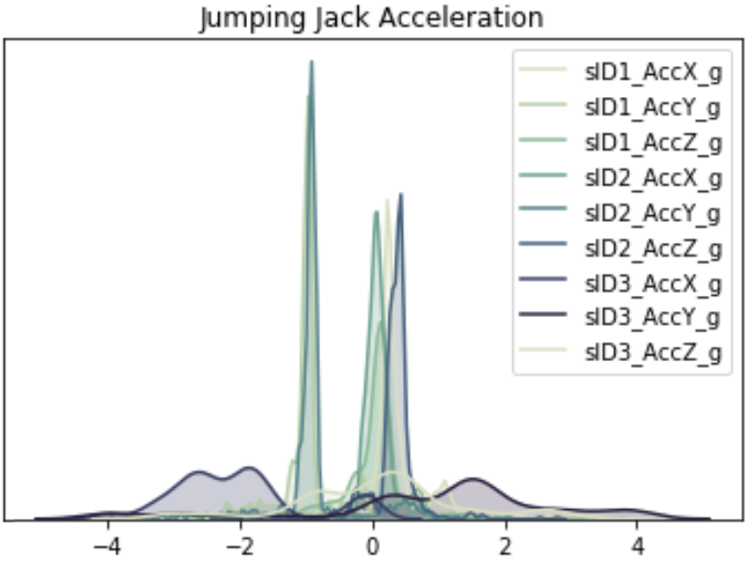
Data
254,606 rows
62 columns
28 Participants
12 Male, 16 Female
Age Range: 20-65 years
Height Range: 61” – 76” (inches) 5’1” – 6’4” (ft-inches)
Movements: Air Squats Jumping Jacks Kettlebell Swings
Density Plot of Jumping Jack Acceleration across all Sensors
Acceleration (m/s²)
Notes:
(19 seconds)(ANDY)
This resulted in 254,606 rows of data and 62 features for model development. Our data consisted of 28 participants, 16 female and 12 male ranged from 20 to 65 years of age. Next, we will talk about how we went about building and selecting the best model for classification of stationary movements.
---------------------------------------------------------------------------------------------------------------------- DON’T INTRODUCE ZACK JUST STOP TALKING

Slide 8
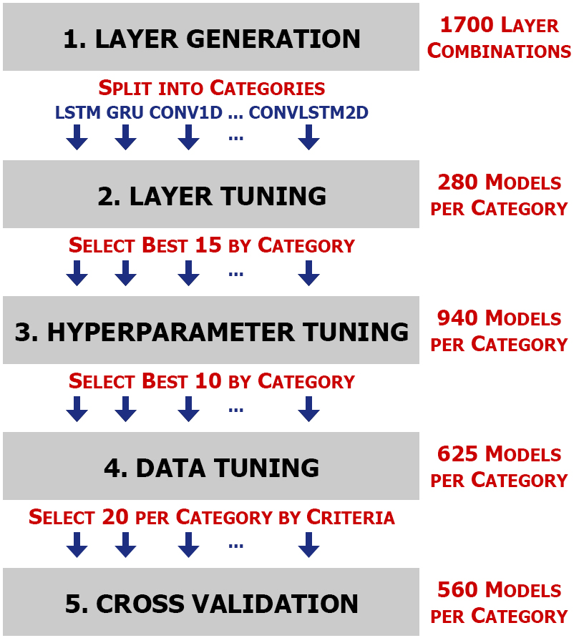
Model Construction and Optimization
Notes:
(71 seconds) (ZACK)
For this dataset, we created a program to generate and tune deep learning models.
Our tuner is broken into 5 steps. Layer Generation, Layer Tuning, Hyperparameter Tuning, Data Tuning, and Cross Validation.
LAYER GENERATION
First we generate all model layer permutations with a layer depth of up to 7, remove all of the invalid layer setups, and make groupings by neural network type. This elimination of layers drops the total count from about 4 million to around 1700 layer combinations.
LAYER TUNING
Second, the program takes those layer setups and runs them with specifically selected hyperparameters.
HYPERPARAMETER TUNING
Third, using sets of hyperparameters which are valid for each layer; random search hyperparameter tuning is done on the best 15 model setups for each type from the previous step.
DATA TUNING
Fourth, we have created a set of data parameters based on our research of other datasets and projects. Using these parameters, we tune the best 10 model setups for each type from the previous step.
CROSS VALIDATION
Finally, in order to verify the results, 20 models per category were run using Leave One Subject Out cross validation.
Due to the way we set up this method, each category can be run in parallel within a step. Without this, this method would take 73 days of time to complete on SMU's ManeFrame.

Slide 9
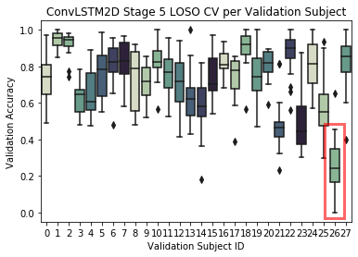
Validation
Subject 26 outlier
The subject did not move their arms during air squats.
Verified best model architectures for classifying stationary movement
Notes:
(23 seconds)(ZACK)
Leave One Subject Out Cross Validation allowed us to view individual subject performance.
One interesting outlier was Subject 26. The subject had a significant drop in accuracy and large variance which we believe to be due to the subject not moving their arms during data capture.
This validation strategy confirmed which neural network architecture performed the best on stationary movement classification.
--------------------------------------
confirmed stage 4's findings of which neural network type are best.
--------------------------------------
This validated our initial findings that the most successful model architectures were the ConvLSTM2D and Conv1D.
As you can see in the graph above, subject 26 produces more variance in validation than any other subject.
--------------------------------------
Our final stage included performing cross validation using a Leave One Subject Out strategy with each of the subjects across the top 20 model architectures.
This resulted in a 15-20% drop in accuracy, but validated our initial findings that the most successful model architectures were the ConvLSTM2D and Conv1D. We believe with more data, our model architecture would produce higher accuracies in our cross validation strategy. As you can see in the graph above, one subject more than most – 26 – produces extreme variance in our accuracies when used at the validation subject.
-------------------------------
Using this proprietary approach, we were able to produce 274 models with an accuracy greater than 95% at predicting stationary exercise. By far the best model architecture involved creating a highly performant model was a convolutional LSTM. This architecture produced the largest number of 100% accuracies at 41 models. Our validation method of the Leave One Subject Out strategy ensures we are not overfitting against our samples, but rather that we have developed a generalizable model for detecting air squats, jumping jacks and kettlebell swings.
--------------------------------
Our results are now coming in as of yesterday and today, with the final ones being complete tomorrow. At the top KNN has 60% accuracy, a vanilla Neural Network has 77%, and the others have 98 to 99% accuracy.
-------------------------
= 85 seconds
To demonstrate the generalizability of our method, on our poster we show our neural network setups run with two benchmarking datasets.
272 TOTAL
4.53 minutes

Slide 10
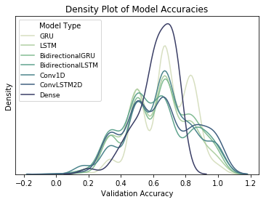
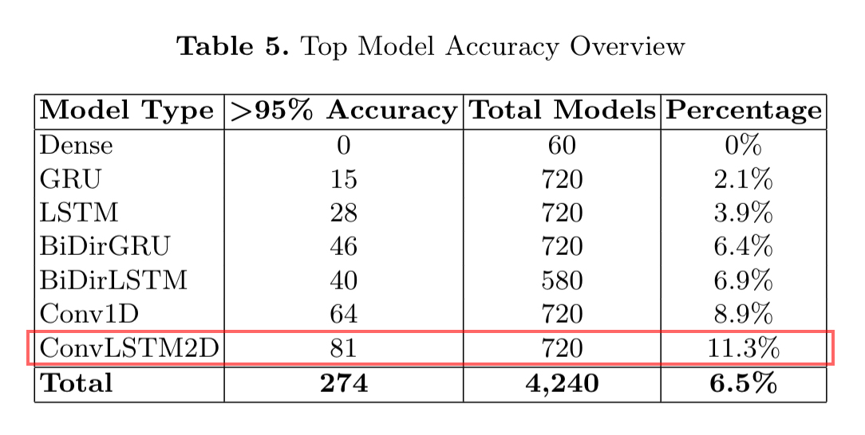
Conclusion
Notes:
(14 seconds)(ZACK)
Our solution produced 274 models in stage 4 with accuracies greater than 95%. This allowed us to see that by far the best model architecture for predicting stationary exercise was the convolutional LSTM type which trained the second fastest.
------------------------------
We were able to produce 274 models with accuracies greater than 95% for predicting stationary exercise. By far the best model architectures were the convolution types which also trained very quickly, with the best being convolutional LSTM.
-------------------------------
Using this proprietary approach, we were able to produce 274 models with an accuracy greater than 95% at predicting stationary exercise. By far the best model architecture involved creating a highly performant model was a convolutional LSTM. This architecture produced the largest number of 100% accuracies at 41 models. Our validation method of the Leave One Subject Out strategy ensures we are not overfitting against our samples, but rather that we have developed a generalizable model for detecting air squats, jumping jacks and kettlebell swings.
--------------------------------
Our results are now coming in as of yesterday and today, with the final ones being complete tomorrow. At the top KNN has 60% accuracy, a vanilla Neural Network has 77%, and the others have 98 to 99% accuracy.
-------------------------
= 85 seconds
To demonstrate the generalizability of our method, on our poster we show our neural network setups run with two benchmarking datasets.
272 TOTAL
4.53 minutes

Slide 11
Future Work
Live detection
Identify subject performance
Improve new subject accuracy
More exercises
Notes:
(21 seconds)(ANDY)
The goal is to leverage this system in a productionalized environment that lets us perform live detection of movements while subjects are wearing the sensors. Our results lay the foundation for future work to identify how subjects are performing in comparison to their peers, improve generalized model accuracy, expand the number exercises, and even create personalized stationary exercise algorithms. Thank you for your time.
Our results lay the foundation for subsequent iterations to improve generalized model accuracy, expand the number exercises, and perform live detection of movement.
4min 48sec
-------------------------------------
The goal is to leverage this algorithm in a productionalized environment that lets us perform live detection of movements while subjects are wearing the sensors. Our results lay the foundation for future work which would enable determining which subjects are not performing certain movements in comparison to their peers.
In other future works, we hope to expand the number exercises and subjects to improve model classification accuracy. Thank you for your time.
------------------------------------
This cross validation approach also sets the stage for the next phase of this project which would entail gathering more subjects.
, which would be to build models to detect how well a subject is performing each of the exercises.
---------
The goal is to expand the number of exercises we can accurately detect with our algorithms, in addition to expanding our information gain to detecting how well an exercise is being completed. By doing so,

